Slide 1

DEPI · TEAM 6 · GROUP G6
Maven Roasters
Coffee Shop
Sales & Peak Hours Analysis
Transforming transactional data into strategic business decisions.
Digital Egypt Pioneers Initiative (DEPI) | Team 6 (Group G6) | Team Lead & Project Members
PROJECT TEAM
Supervising Engineer: Eng. Ahmed Ayman El-Saay
Team Leader: Omnia Samir
Team Members: Ragab Samir, Ali Tawfik, Hagar Aly, Haidy Adel , Toka El haddad

Slide 2
THE OPERATIONAL DILEMMA
The same shop carries two very different problems.
Peak demand creates friction. Off-peak capacity sits unused.
10:00 AM
3:00 PM
Long wait
Empty shop
At 10:00 AM, customers wait a long time for coffee before work.
At 3:00 PM, the shop is quiet and staff have little to do.
Core problem: the issue is not just traffic; it is lost revenue, missed opportunities, and operational inefficiency.
Project goal: turn daily sales data into a roadmap that optimizes operations and drives revenue.
2

Slide 3
TEAM ROADMAP & TECHNICAL ARCHITECTURE
From raw transactions to an interactive decision tool.
Each team pair owns one layer of the workflow.
01
02
03
Data Cleaning & ETL
Advanced SQL & Aggregations
Power BI & DAX Design
ALY & HAIDY
OMNYA & HAGER
Cleaned and transformed the data with SQL Server and Power Query; created vw_coffee_sales and derived date/time columns.
RAGAB & TOQA
Built the model and measures such as AOV and Peak Hour for the interactive dashboard.
Calculated peak hours, store performance, and day-part metrics.
3

Slide 4



PEAK HOUR
MORNING RUSH
EXECUTIVE DASHBOARD
10:00 AM
388K
Morning Rush is the commercial center of gravity.
identified with dynamic DAX measures
55.56% of revenue
THREE FINDINGS TO ACT ON
10:00 AM is the peak hour. Demand concentration makes staffing and queue design time-sensitive.
The dashboard turns transactional data into a view of when demand peaks, where revenue concentrates, and how stores compare.
Morning Rush leads performance. It contributes 388K, or 55.56% of revenue, and leads transaction volume.
.
Store context matters. The dashboard compares Astoria, Lower Manhattan, and Hell’s Kitchen to surface location-specific opportunities.
4

Slide 5
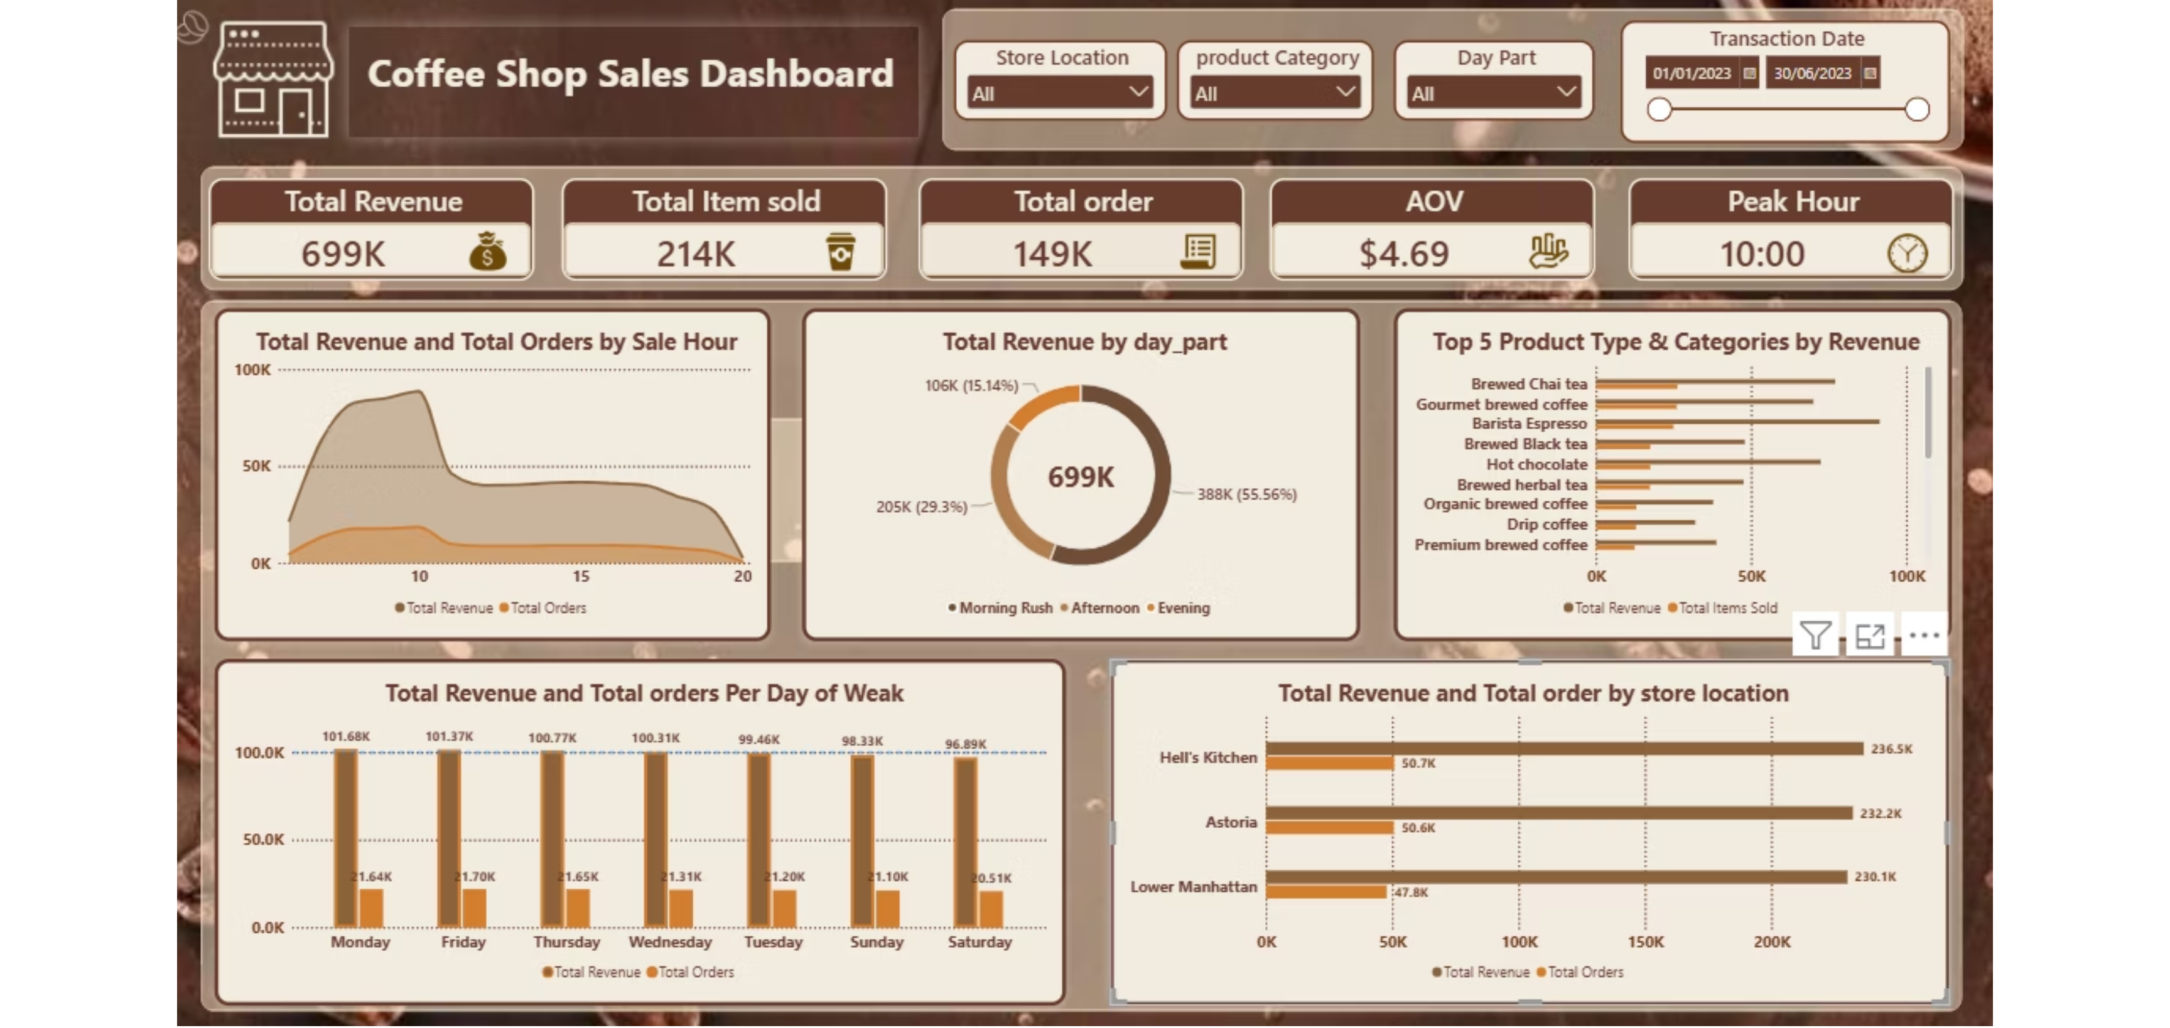
Executive Dashboard Preview
5

Slide 6
Dashboard Insights
Peak Hour is 10:00 AM with 18,545 orders and $88,673.39 revenue
Morning Rush leads day-part revenue with $388,288.67, 81,751 orders, and $4.75 average transaction value
Friday is the strongest day by revenue at $101,373.00; Saturday is the weakest at $96,894.48
Hell’s Kitchen leads store revenue at $236,511.17, followed by Astoria at $232,243.91 and Lower Manhattan at $230,057.25
6

Slide 7





Strategic Business Recommendations
Staff scheduling
AOV upselling
Add barista and cashier capacity around the 10:00 AM Morning Rush peak.
Feature Barista Espresso ($91,406.20) with bakery add-ons.
Inventory management
Off-peak promotions
Protect stock for Barista Espresso, Brewed Chai ($77,081.95), and Hot Chocolate ($72,416.00).
Run targeted offers on Saturday and during Afternoon/Evening periods.
Location action
Use Hell’s Kitchen as the benchmark; improve Lower Manhattan performance.
7

Slide 8

SUMMARY & NEXT STEPS
Data becomes useful when it changes the next decision.
Integrated SQL, Power Query, and Power BI to address a real operational challenge.
Converted transactional data into decisions about staffing, upselling, inventory, and off-peak demand.
Next step: carry the same analytical discipline and team collaboration into the Capstone Final Project.

